Slide 1
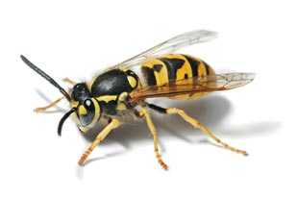
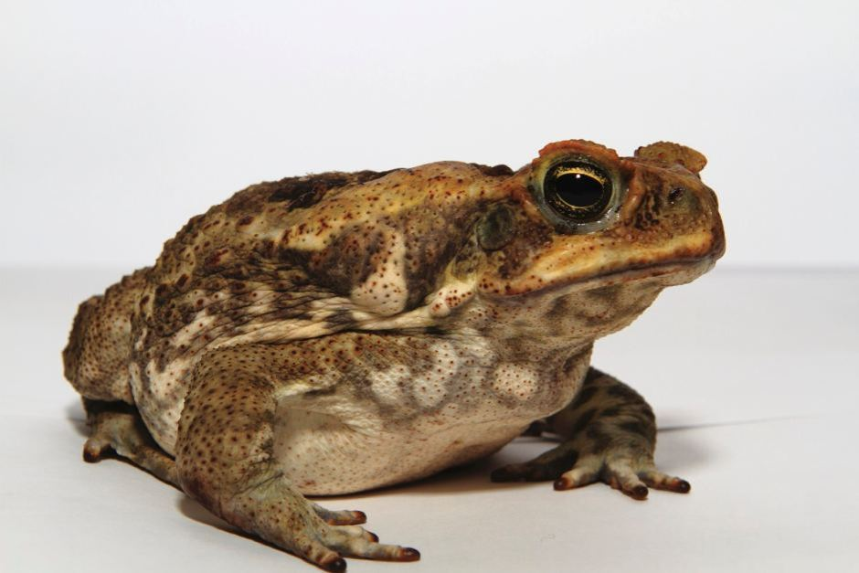
Introduced species
An introduced species is a type of organism that humans have brought to somewhere it does not normally live.
These organisms can reduce the population of native species by competing for food and nest sites.
Examples:
The European wasp, introduced to mainland Australia in the 1970s, has no natural predators. A single nest can consume thousands of native insects.
The cane toad was introduced in the 1930s to combat pests. It not only failed to do this, but also reduced the population of animals that tried to eat it, including some native lizards, snakes, and even crocodiles.

Slide 2
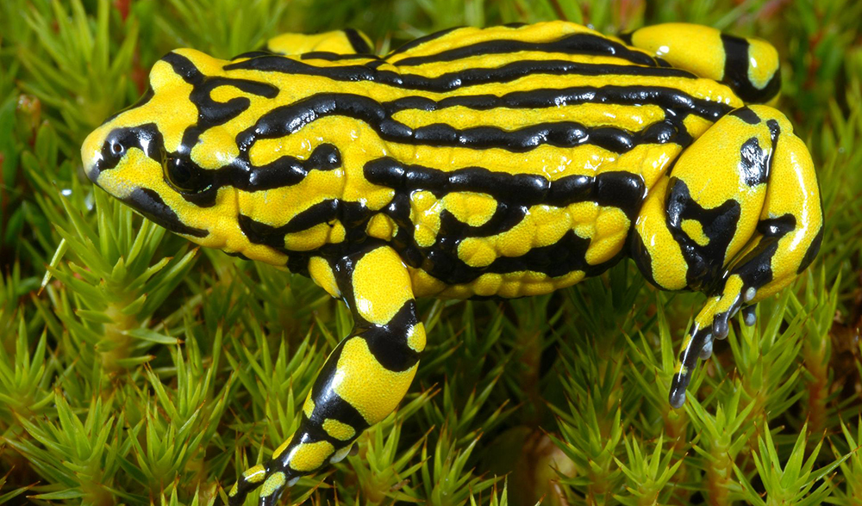
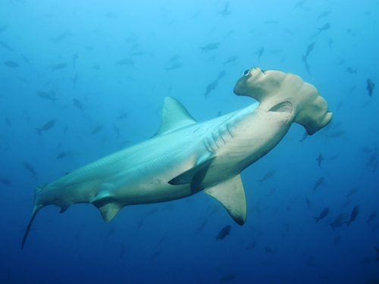
Loss of organisms
Human activity and natural disasters can kill large amounts of organisms very quickly.
When an organism is removed from an ecosystem, the organisms it used to eat tend to thrive, but those that used to eat it struggle to find food.
Examples:
When amphibians (e.g. frogs) are killed by man-made chemicals, insect populations (including mosquitoes) increase.
Overfishing of large sharks increases the population of smaller sharks and rays, which in turn decreases the population of shellfish.

Slide 3
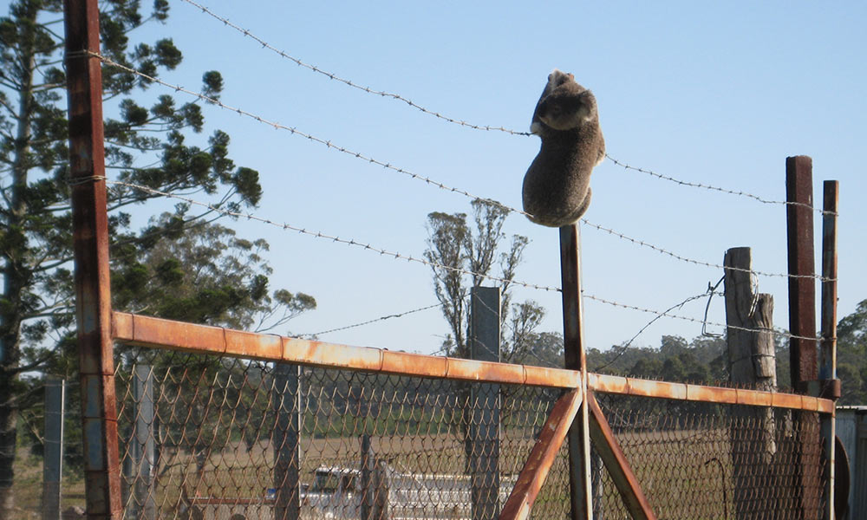
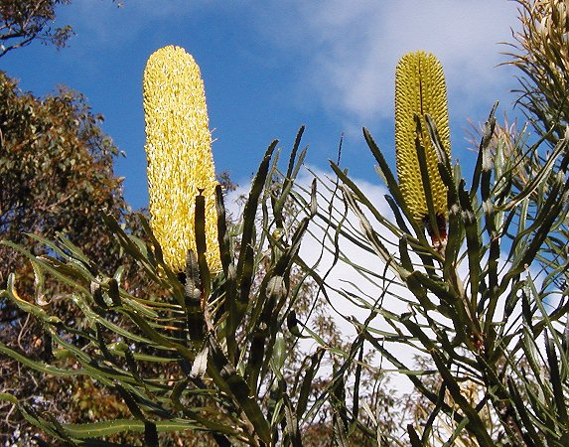
Deforestation
Building houses, farms and factories often involves cutting down trees and destroying swamps and grasslands.
This forces organisms in those habitats to either move, adapt or die.
Examples:
Clearing of bushland in eastern Australia is threatening local koala populations.
The Slender Banksia, which is native to Western Australia, is an endangered species that is threatened by deforestation.

Slide 4
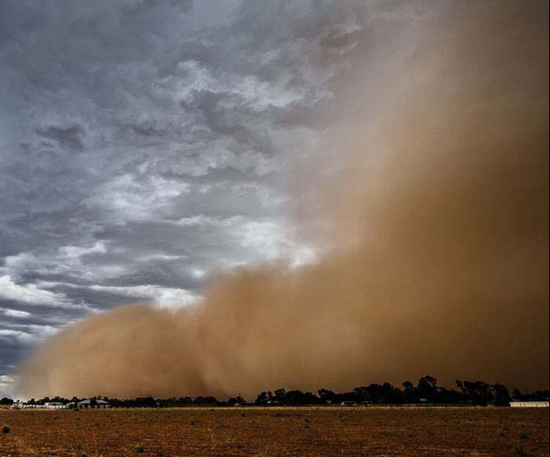
Land degradation
Trees and other plants protect the soil from the wind and rain. If these plants are removed, the soil is exposed.
The top layer of soil has a large amount of nutrients, so if it is carried away by the wind and rain, it is difficult for plants to grow.
Examples:
Dust quantity is used as an indicator of the health of the Australian landscape.
Exposed soil can form large, damaging dust storms.

Slide 5
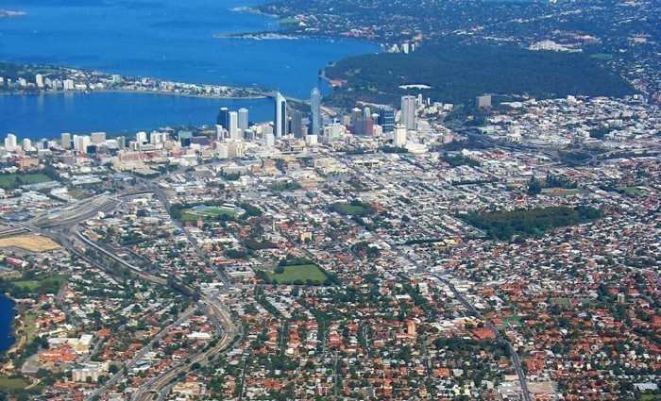
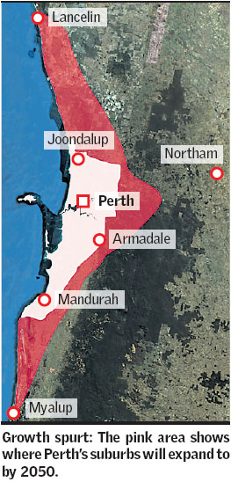
Urban sprawl
Examples:
Perth’s urban sprawl is one of the biggest in the world. Because of this:
People are driving further, increasing air pollution
Native vegetation has been removed to make space for houses and businesses
Urban sprawl is the spread of cities and towns into rural areas (e.g. farmlands, forests, coastal lands).
This can result in the destruction of organisms and habitats, and can introduce new predators (e.g. cats and dogs).

Slide 6
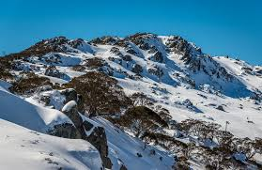
Climate change
Climate change refers to any long-term change to weather patterns, whether natural or caused by human activity.
If organisms cannot adapt to these changes fast enough, they may not survive.
Examples:
The eruption of Krakatoa in 1883 lowered global temperatures by an average of 1.2 °C for the next year.
Australia’s alpine (mountainous) areas are experiencing increased temperatures and decreased snowfall, which is damaging the alpine habitat.

